Slide 1
Introduction to Predictive Analytics
Introduction to Analyzing Data for Business Goals

Slide 2
Learning Goals
Evaluate a scenario and discuss the optimal predictive modeling technique(s) to achieve business goals.
Investigate considerations for how predictive analytics will help you solve the business problem for your final project.
Define predictive analytics and the techniques of predictive analytics.

Slide 3
Predictive Analytics
What is predictive analytics?
Your model’s “goodness” is measure by how it scores on new data
Ex. Student practice exams VS final exam

Slide 4
Example Questions Across Industry
Field | Descriptive Analytics | Diagnostic Analytics | Predictive Analytics | Prescriptive Analytics
Healthcare | How many patients went to the hospital/clinic last week? | Why did these patients go to the hospital? | Which patient is likely to need hospitalization? | Extra home treatment to prevent visits
Life science | What are the total medicines available by pharmaceuticals? | Why do we not have more medicines or pharmaceuticals? | Which pharmaceutical is likely to monopolize the production of medicines? | Increase the number of pharmaceuticals and medicines
Finance | Where was the stock market in the last 6 months? | Why was the stock market that high/low? | What will the level be for the stock market in the next 6 months? | Reduce downside risk by diversifying a portfolio
Politics | Who was elected last? | Why were they elected? | Who will be elected next? | Increase voter education to reduce downside societal impact
Education | How many students are learning online? | Why are they taking courses online? | How many more courses are needed to support them? | Increase the number of courses
Non-profit | How are non-profits independent? | Why are they effective? | How many more non-profits can be created? | Decrease barriers to creating non-profits
Human rights | What is the number of refugees in the world? | Why are there so many refugees? | What are the likely future sources of refugees? | Reduce colonialism, imperialism, 'isms and let people live

Slide 5
Business Questions to Answer
How will sales change over the next year?
What trends in fashion and style will be popular next spring?
How likely is this customer to pay back their loan?
Should I insure this new driver?
Should I extend a loan to a young couple with no credit history?
…
…
…
…
…
…

Slide 6
Predictive Analytics - Techniques & Methodologies
Supervised Learning
Unsupervised Learning

Slide 7
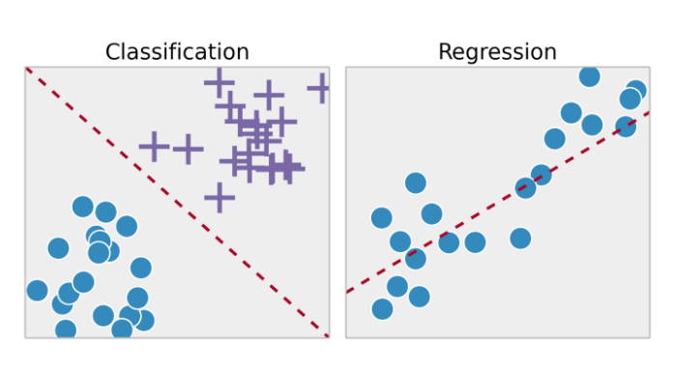
Predictive Analytics - Techniques & Methodologies
Types of Supervised Learning: Classification & Regression

Slide 8
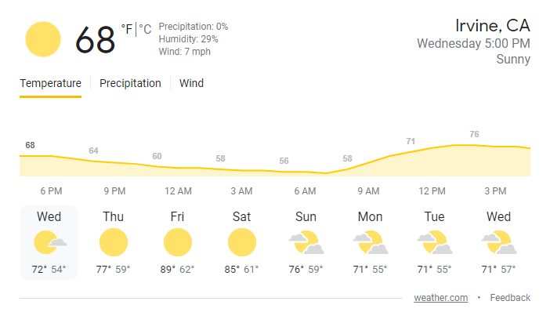
Regression VS Classification
Regression
Question: What is the temperature going to be tomorrow?
Answer: 78 Degrees

Slide 9

Regression VS Classification
Classification
Question: Will it be Cold or Hot Tomorrow?
Answer: HOT

Slide 10
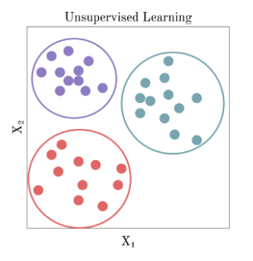
Predictive Analytics - Techniques & Methodologies
Unsupervised Learning: Clustering

Slide 11
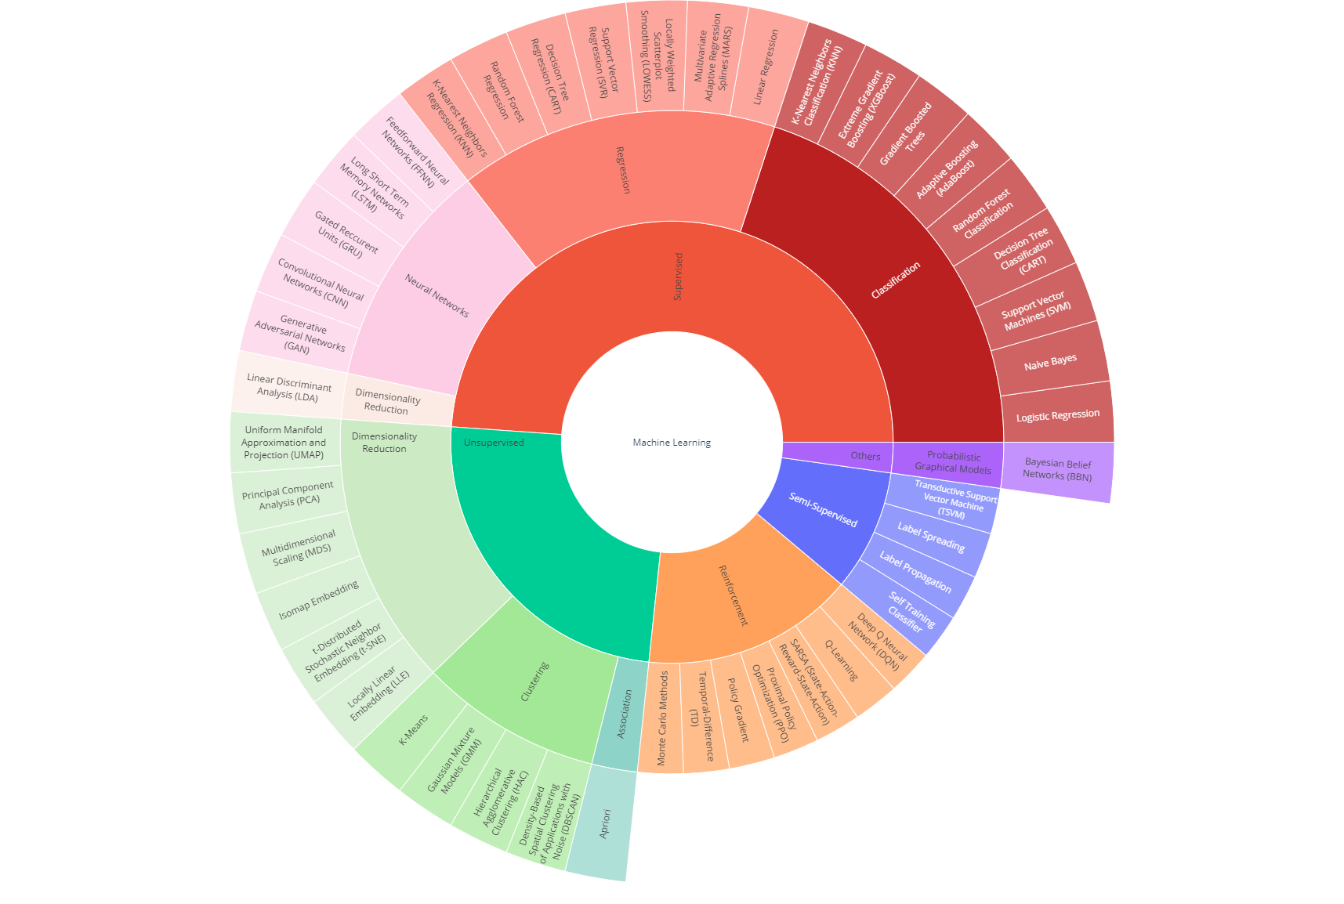
Good Reference
https://towardsdatascience.com/linear-regression-made-easy-how-does-it-work-and-how-to-use-it-in-python-be0799d2f159
Notes:
plotly
https://towardsdatascience.com/linear-regression-made-easy-how-does-it-work-and-how-to-use-it-in-python-be0799d2f159

Slide 12
Business Challenges
Error-Prone Data
Bias-Variance Tradeoff
Underfit
Overfit
Interpretation & Subjectivity

Slide 13
Bias-Variance Tradeoff (BVT)
Bias – Difference between a model’s prediction and the truth (the actual values)
Training error
High bias - poor modeling (very little patterns are captured), underfitting, due to lack of representation
Variance – variability of a model’s prediction between training and test data sets
Test/validation error
High variance – poor modeling (capturing signal and noise in data), overfitting, due to overrepresentation
Ideal case: low bias and low variance

Slide 14
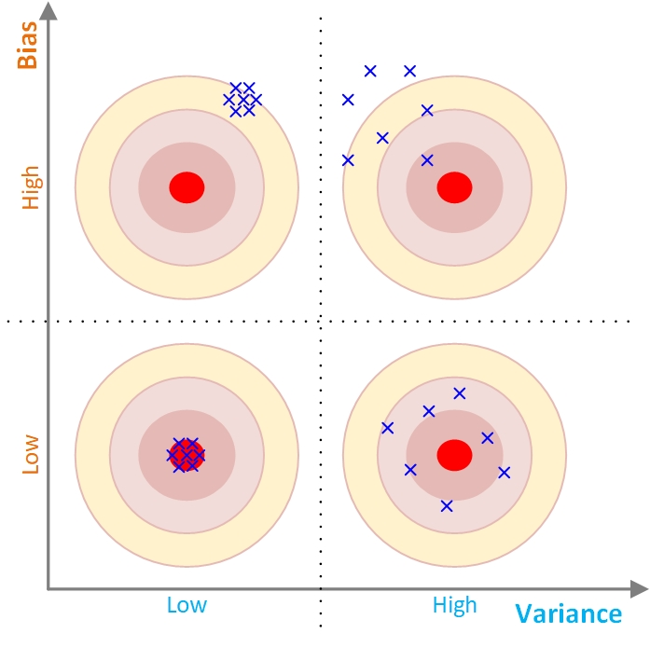
Bias-Variance Tradeoff (BVT)
Tradeoff is between accuracy and consistency
We want to be consistently accurate (the quadrant with low bias and low variance)

Slide 15
Business Challenges
Underfit: An underfit model is unable to accurately predict variations in the output. You would realize this when applying the model to a test dataset.
For example, suppose you develop a model designed to predict an automobile’s gas mileage given its weight. Light cars have higher gas mileage while heavy cars have lower gas mileage. If your model shows little variation in its predictions regardless of the cars’ weight, it is probably underfitting.

Slide 16
Business Challenges
Overfit: In contrast, an overfit model shows variations in the output that are not actually present.
Again, you would realize this when applying the model to a test dataset.
For instance, suppose you’re developing a model designed to predict a person’s income tax given their income. An overfit model manages to correctly predict each data point. However, this doesn’t necessarily mean that it would be accurate for “new” data (data that the model hasn’t previously “seen”).
In the figure, the model diverges significantly from what you might expect in between the last two data points.
A model that is less complex might actually be more useful and accurate for new data. The figure also shows the output of an underfit model, for comparison.

Slide 17
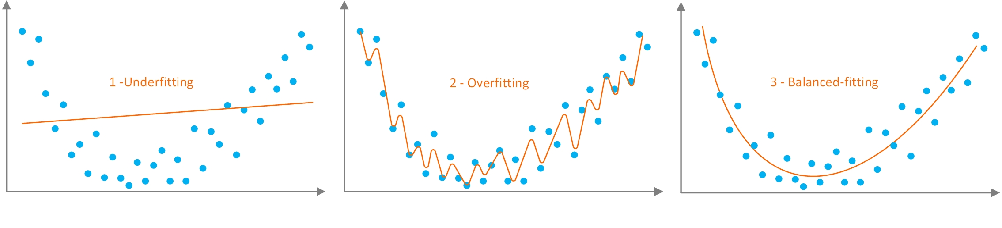
Bias-Variance Tradeoff (BVT)
Overfitting/training vs underfitting/training
The goal is to capture the signal and stop the learning before starting to capture the noise.
Generalizability is needed for predictability
Prediction vs curve-fitting

Slide 18
Linear Regression (LR)
Correlation
Relationship between variables (X,Y)
Variables move together
X, Y can be interchanged
Relation is represented by a point
Regression
One variable affects another (X,Y)
Cause and effect
X,Y cannot be interchanged
Relation is represented by a line
Notes:
Predicting taxi fare based on distance traveled
Predicting rainfall based on time of the year and location
Predicting the homicide rate in the area based on income level and the prevalence of gun ownership
Correlation (the relationships)
Regression (the mathematics behind the relationship)

Slide 19
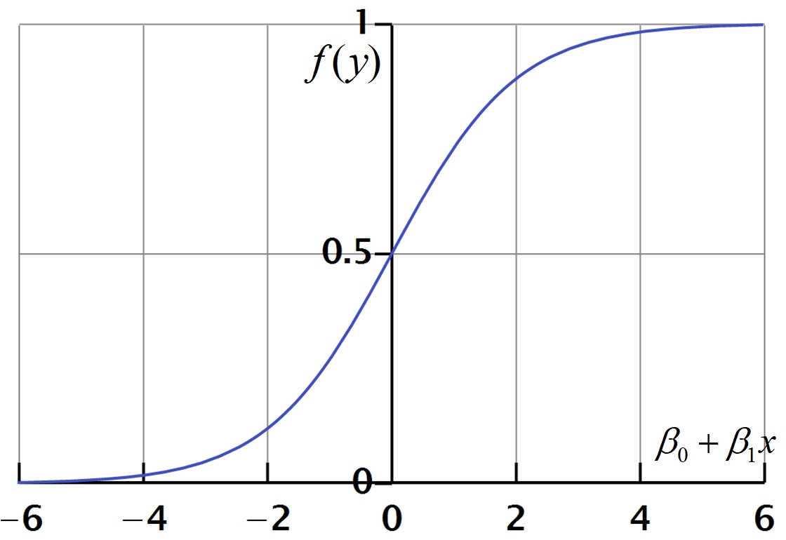
Logistic Regression
Most popular statistical technique for classification type prediction problems
Developed in 1940s
It calculates the probability of the outcomes
Notes:
To predict whether an email is spam (1) or (0)
Whether the tumor is malignant (1) or not (0)

Slide 20
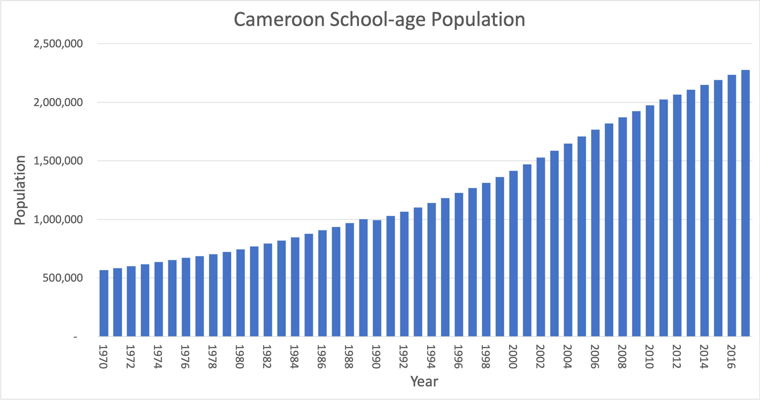
Achieving Business Goals with Predictive Analytics
Discussion: Consider education in the country of Cameroon. If you are a government official responsible for ensuring that schools have sufficient resources, it would obviously be very useful to be able to predict the number of school-age children that could potentially be attending school in the future so you can ensure that resources are available.
Figure 5: School-age population for Cameroon

Slide 21
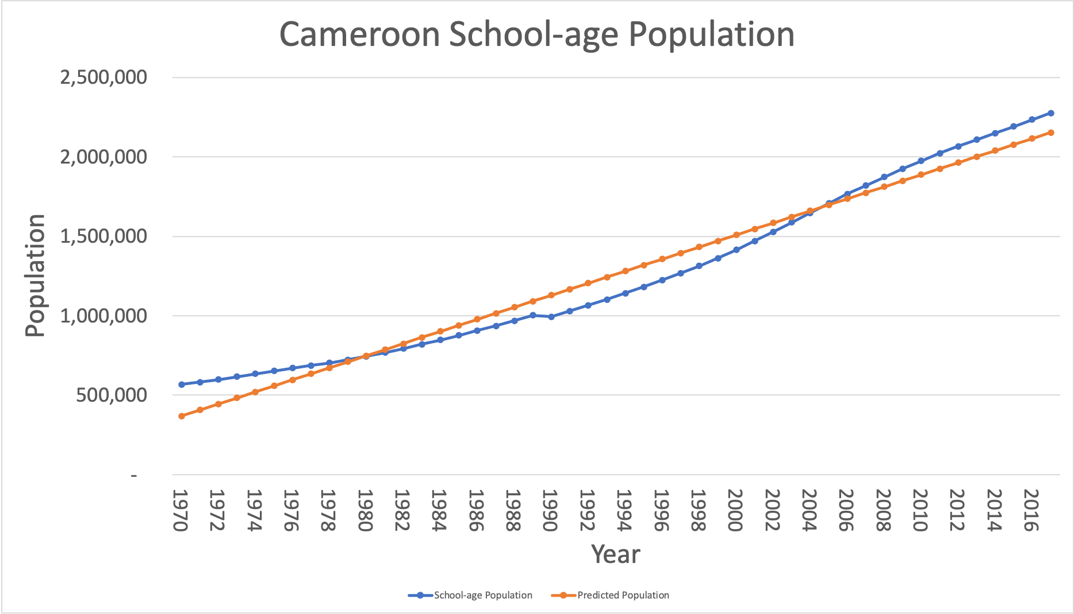
Achieving Business Goals with Predictive Analytics

Slide 22
Advanced Topics in Predictive Modeling
Predictive analytics is still a mix of art and science
Experimentation and heuristics (Algorithms) dominate the process
In predictive analytics, the goal is to develop models that are
Highly predictive (on holdout data)
Unbiased (objective for all outcomes)
Interpretable (transparent and explainable)
Computationally efficient
Robust and scalable
Easily deployable
Standardized processes and methodologies helped predictive analytics to become a scientific practice
Much more is needed to reach the scientific state

Slide 23

Q&A
What questions and comments do you have?

Slide 24
Application Case: To Imprison or Not to Imprison—A Predictive Analytics-Based DSS for Drug Courts
Use of predictive analytic in social context for behavioral problems has been rare, at best
As the digitized data become readily available, these domains have also ventured into discovering new and actionable insight via predictive analytics and data science
In this application case, a large and feature rich data is used to develop decision support systems for drug courts

Slide 25
Demo:
Topics
Student Q&A
Notes:
outline for a demo, if applicable

